Slide 1


Prof. Filipe Dwan Pereira
Inteligência artificial
Otimização por colônia de formigas

Slide 2
Disclaimer:
Esta aula é baseada nos slides e materiais do professor Guilherme Matos - IA Expert Academy

Slide 3
ANT COLONY OPTIMIZATION (ACO)
Ant Colony Optimization (ACO)
Applications
Algorithm proposed by Dorigo, in 1992
1.Internet routing
2.GPS systems
3.Edge detection in images
It is based on the foraging behavior of ants in search for food
Ants communicate with pheromones, and they tend to follow pheromone trails (stygmergy)
Pheromone evaporates with time

Slide 4
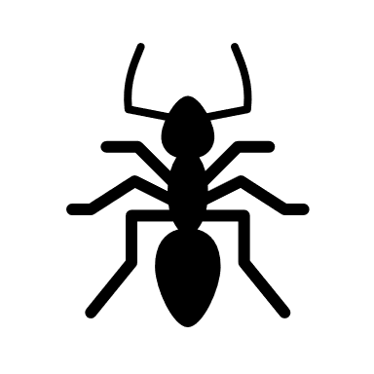
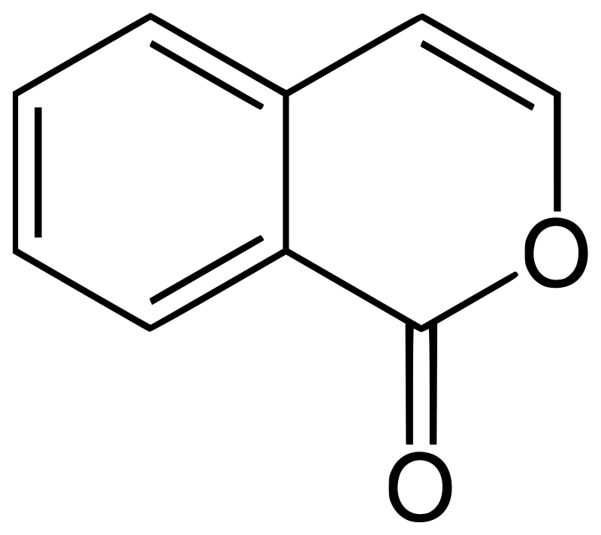
PHEROMONE RELEASE

Slide 5
PHEROMONE EVAPORATION

Slide 6
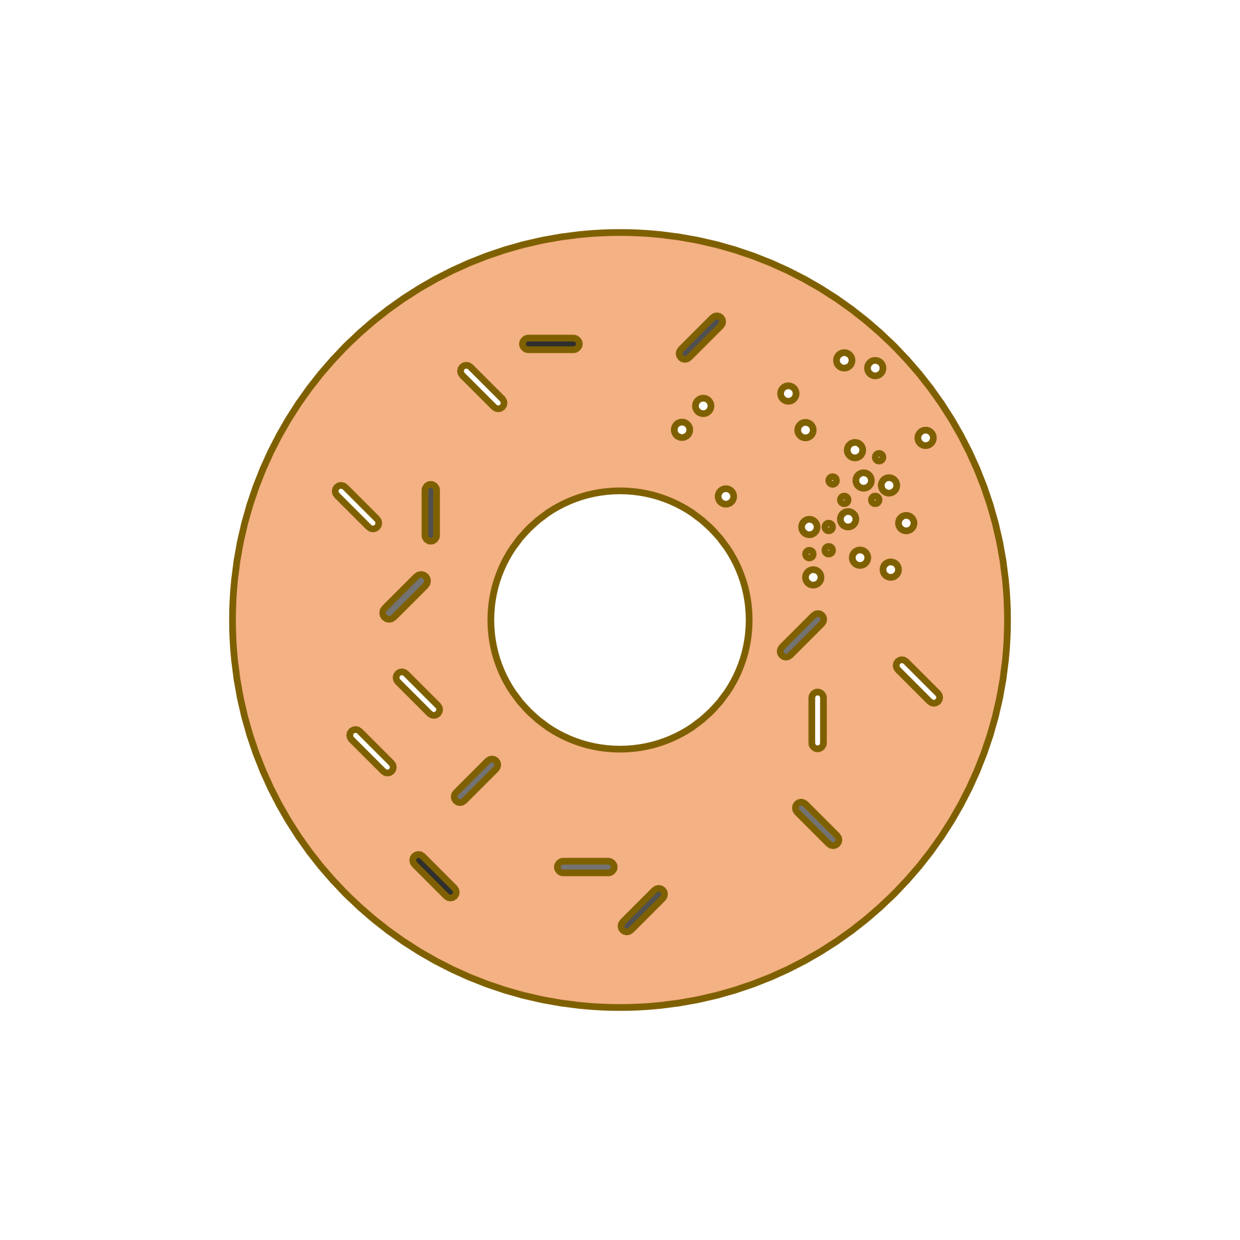
FOOD FORAGING BEHAVIOR
Food

Slide 7
FOOD FORAGING BEHAVIOR

Slide 8
FOOD FORAGING BEHAVIOR
Food

Slide 9
FOOD FORAGING BEHAVIOR
Food

Slide 10
FOOD FORAGING BEHAVIOR
FOOD FORAGING BEHAVIOR
Food

Slide 11
ANT COLONY OPTIMIZATION (ACO)
FOOD FORAGING BEHAVIOR
Food

Slide 12
PHEROMONE CONCENTRATION AS A SHORTCUT

Slide 13
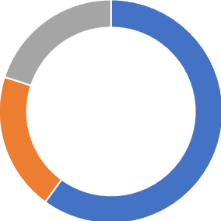
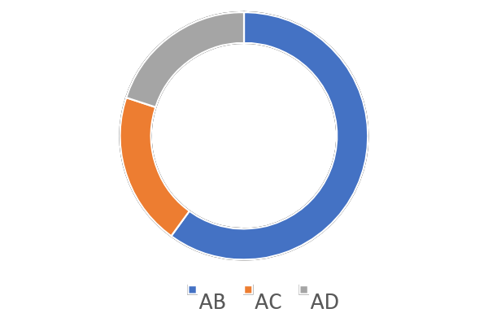
ROULLETE WHEEL TECHNIQUE
[AB,AC,AD]
[0.6,0.2,0.2]
AB: 0.6
AC: 0.2
AD: 0.2
0.6
0.2
0.2
0
0.6
0.8
1
count = 0
If R < 0.6: count = 0
If R < 0.8: count = 1
If R > 0.8: count = 2
R = 0.34
Index [0]
[AB,AC,AD]
[0.6,0.2,0.2]

Slide 14
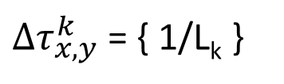
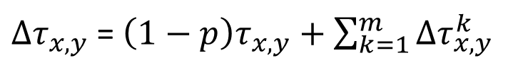
PHEROMONE UPDATE
K = ant
x,y = edge from x to y
L_{k} = length of the path
Current level of pheromone deposited
Evap. constant
Pheromone to the added

Slide 15
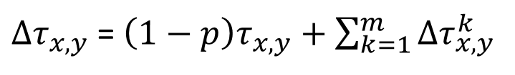
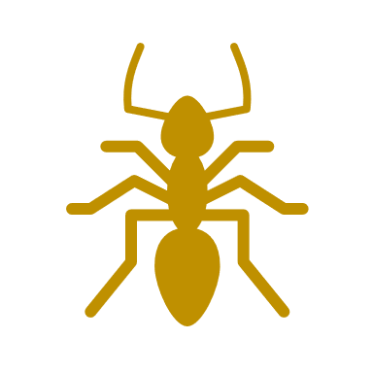
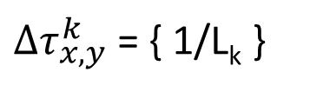

PHEROMONE UPDATE
m = n. of ants
Current level of pheromone deposited
5
5
4
9
Evap. constant
Pheromone to the added
3
3
In turn, the amount of pheromone deposited by a certain ant k on the path x,y is given by 1/Lk, that is, 1/length of the path
5
5
4
Const. Evaporation ρ: 0.3
9
3
3

Slide 16
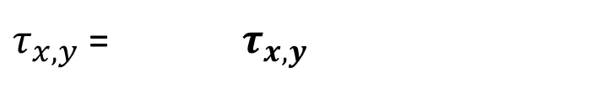

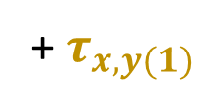

PHEROMONE UPDATE
1/10
1
*0,7
*0,7
+1/10+1/12
1/10
1
+1/10
5
4
5
5
5
4
1
*0,7
+1/12
9
*0,7
1
3
3
9
3
3
1
+1/12
*0,7
1
*0,7
1/12
5
4
1/12
5
9
1/12
3
3

Slide 17
PHEROMONE UPDATE
1
*0.7
*0.7
+1/10+1/12
1
+1/10
0.8333
5
0.8
5
5
4
1
5
*0.7
+1/12
4
0.78333
*0.7
1
0.7
9
9
3
3
1
+1/12
3
3
*0.7
1
*0.7
0.78333
0.7

Slide 18
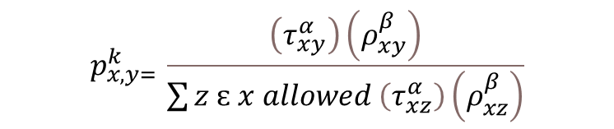


PROBABILITY OF EDGE SELECTION
z
Probability to choose the edge from point x to point y
x
y
z
= pheromone deposit
= path quality
(1/path length)
α and β are values greater than 0 that are used to control the influence of the pheromone deposit and the path distance. Most often they are set at 1.

Slide 19
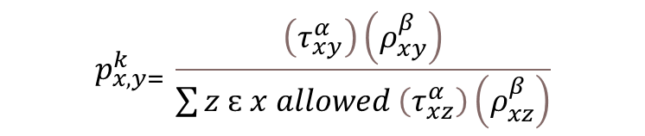


PROBABILITY OF EDGE SELECTION
1
1
1
1
1
1
= pheromone deposit
= path quality
5
5
4
9
3
3

Slide 20
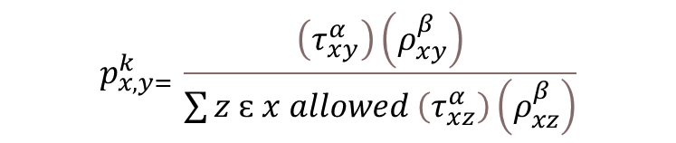
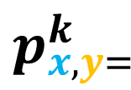


PROBABILITY OF EDGE SELECTION
(1) X (1/5)
0.31
(1) X (1/5)
+ (1) X (1/9)
+ (1) X (1/3)
= pheromone deposit
= path quality
1
1
1
1
1
1
0.31
5
5
4
9
3
3

Slide 21
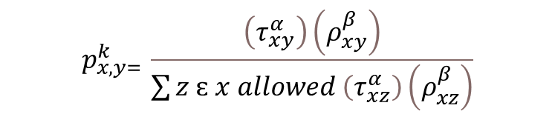
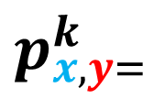


PROBABILITY OF EDGE SELECTION
(1) X (1/9)
0.17
(1) X (1/5)
+ (1) X (1/9)
+ (1) X (1/3)
= pheromone deposit
= path quality
1
1
1
1
1
1
0.31
0.17
5
5
4
9
3
3

Slide 22
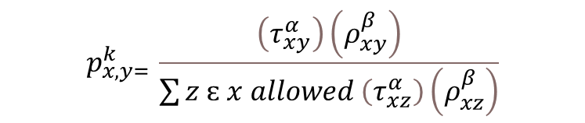
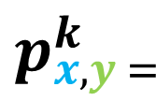


PROBABILITY OF EDGE SELECTION
(1) X (1/3)
0.52
(1) X (1/5)
+ (1) X (1/9)
+ (1) X (1/3)
= pheromone deposit
= path quality
1
1
1
1
1
1
0.31
0.17
5
5
4
9
0.52
3
3

Slide 23
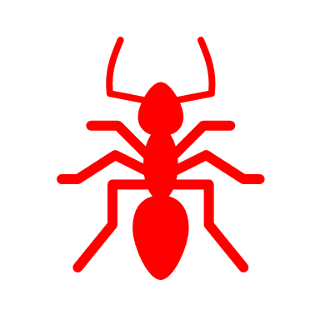

B
Edges
AB: 1; 1; (BD, BC)
AD: 3; 1; (---)
AC: 1.5; 1; (CD)
BD: 1.5; 1; (AB, CD)
CD: 1.5; 1; (---)
BC: 2; 1; (AC, AB, BD, CD)
1
1.5
2
A
D
3
1.5
1.5
C

Slide 24
B
1 (1/1)
Edges
AB: 1; 1; (BD, BC)
AD: 3; 1; (---)
AC: 1.5; 1; (CD)
BD: 1.5; 1; (AB, CD)
CD: 1.5; 1; (---)
BC: 2; 1; (AC, AB, BD, CD)
0.66(1/1.5)
0.5 (1/2)
A
D
0.33 (1/3)
0.66 (1/1.5)
0.66 (1/1.5)
C

Slide 25
B
1 (1/1)
Edges
AB: 1; 1; (BD, BC)
AD: 3; 1; (---)
AC: 1.5; 1; (CD)
BD: 1.5; 1; (AB, CD)
CD: 1.5; 1; (---)
BC: 2; 1; (AC, AB, BD, CD)
0.66(1/1.5)
0.5 (1/2)
A
D
0.33 (1/3)
0.66 (1/1.5)
0.66 (1/1.5)
C

Slide 26
B
1 (1/1)
Edges
AB: 1; 1; (BD, BC)
AD: 3; 1; (---)
AC: 1.5; 1; (CD)
BD: 1.5; 1; (AB, CD)
CD: 1.5; 1; (---)
BC: 2; 1; (AC, AB, BD, CD)
0.66(1/1.5)
0.5 (1/2)
A
D
0.33 (1/3)
0.66 (1/1.5)
0.66 (1/1.5)
C

Slide 27
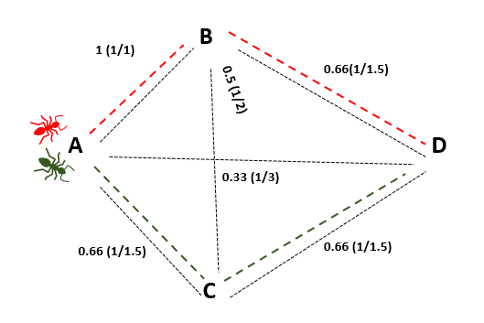
2 Ants
AB,BD
Path length: 2.5
Pheromone deposited: 1/2.5 (0.4)
AC, CD
Path length : 3
Pheromone deposited : 1/3 (0.33)
Edges
AB: 1; 1; (BD, BC)
AD: 3; 1; (---)
AC: 1.5; 1; (CD)
BD: 1.5; 1; (AB, CD)
CD: 1.5; 1; (---)
BC: 2; 1; (AC, AB, BD, CD)
Edges
AB: 1; 0.7*1+0.4; (BD, BC)
AD: 3; 0.7*1; (---)
AC: 1.5; 0.7*1+0.33; (CD)
BD: 1.5; 0.7*1+0.4 (AB, CD)
CD: 1.5; 0.7*1+0.33; (---)
BC: 2; 0.7*1; (AC, AB, BD, CD)
Edges
AB: 1; 1.1; (BD, BC)
AD: 3; 0.7; (---)
AC: 1.5; 1.033; (CD)
BD: 1.5; 1.1; (AB, CD)
CD: 1.5; 1.033; (---)
BC: 2; 0.7; (AC, AB, BD, CD)

Slide 28
B
1.1 (1.1/1)
0.73(1.1/1.5)
Edges
AB: 1; 1.1; (BD, BC)
AD: 3; 0.7; (---)
AC: 1.5; 1.033; (CD)
BD: 1.5; 1.1; (AB, CD)
CD: 1.5; 1.033; (---)
BC: 2; 0.7; (AC, AB, BD, CD)
0.35 (0.7/2)
A
D
0.23 (0.7/3)
0.68 (1.033/1.5)
0.68 (1.033/1.5)
C

Slide 29
B
1.1 (1.1/1)
0.73(1.1/1.5)
Edges
AB: 1; 1.1; (BD, BC)
AD: 3; 0.7; (---)
AC: 1.5; 1.033; (CD)
BD: 1.5; 1.1; (AB, CD)
CD: 1.5; 1.033; (---)
BC: 2; 0.7; (AC, AB, BD, CD)
0.35 (0.7/2)
A
D
0.23 (0.7/3)
0.68 (1.033/1.5)
0.68 (1.033/1.5)
C

Slide 30
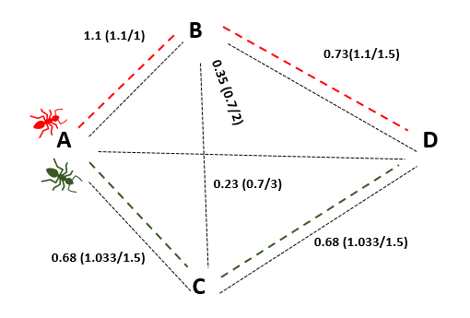
2 Ants
AB,BD
Path length: 2.5
Pheromone deposited: 1/2.5 (0.4)
AB, CD
Path length : 3
Pheromone deposited : 1/3 (0.33)
Edges
AB: 1; 1.1; (BD, BC)
AD: 3; 0.7; (---)
AC: 1.5; 1.033; (CD)
BD: 1.5; 1.1; (AB, CD)
CD: 1.5; 1.033; (---)
BC: 2; 0.7; (AC, AB, BD, CD)
Edges
AB: 1; 0.7*1.1+0.4; (BD, BC)
AD: 3; 0.7*0.7; (---)
AC: 1.5; 0.7*1.033+0.33; (CD)
BD: 1.5; 0.7*1.1+0.4 (AB, CD)
CD: 1.5; 0.7*1.033+0.33; (---)
BC: 2; 0.7*0.7; (AC, AB, BD, CD)
Edges
AB: 1; 1.17; (BD, BC)
AD: 3; 0.49; (---)
AC: 1.5; 1.05; (CD)
BD: 1.5; 1.17 (AB, CD)
CD: 1.5; 1.05; (---)
BC: 2; 0.49; (AC, AB, BD, CD)

Slide 31
B
1.17 (1.17/1)
0.78(1.17/1.5)
Edges
AB: 1; 1.17; (BD, BC)
AD: 3; 0.49; (---)
AC: 1.5; 1.05; (CD)
BD: 1.5; 1.17 (AB, CD)
CD: 1.5; 1.05; (---)
BC: 2; 0.49; (AC, AB, BD, CD)
0.24 (0.49/2)
A
D
0.16 (0.49/3)
0.7 (1.05/1.5)
0.7 (1.05/1.5)
C

Slide 32
B
1.17 (1.17/1)
0.78(1.17/1.5)
Edges
AB: 1; 1.17; (BD, BC)
AD: 3; 0.49; (---)
AC: 1.5; 1.05; (CD)
BD: 1.5; 1.17 (AB, CD)
CD: 1.5; 1.05; (---)
BC: 2; 0.49; (AC, AB, BD, CD)
0.24 (0.49/2)
A
D
0.16 (0.49/3)
0.7 (1.05/1.5)
0.7 (1.05/1.5)
C

Slide 33
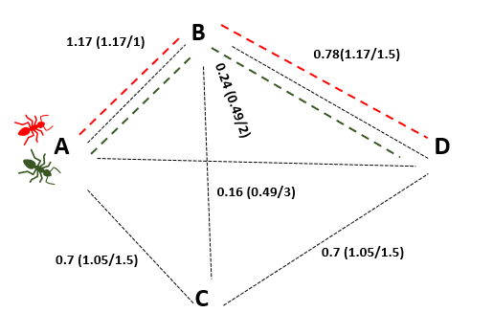
2 Ants
AB,BD
Path length: 2.5
Pheromone deposition: 1/2.5 (0.4)
AB, BD
Path length : 2.5
Pheromone deposition: 1/2.5 (0.4)
Edges
AB: 1; 1.17; (BD, BC)
AD: 3; 0.49; (---)
AC: 1.5; 1.05; (CD)
BD: 1.5; 1.17 (AB, CD)
CD: 1.5; 1.05; (---)
BC: 2; 0.49; (AC, AB, BD, CD)
Edges
AB: 1; 0.7*1.17+0.4+0.4; (BD, BC)
AD: 3; 0.7*0.49; (---)
AC: 1.5; 0.7*1.05; (CD)
BD: 1.5; 0.7*1.17+0.4+0.4 (AB, CD)
CD: 1.5; 0.7*1.05; (---)
BC: 2; 0.7*0.49; (AC, AB, BD, CD)
Edges
AB: 1; 1.62; (BD, BC)
AD: 3; 0.34; (---)
AC: 1.5; 0.73; (CD)
BD: 1.5; 1.62 (AB, CD)
CD: 1.5; 0.73; (---)
BC: 2; 0.34; (AC, AB, BD, CD)

Slide 34
B
1.62 (1.62/1)
1.08 (1.62/1.5)
Edges
AB: 1; 1.62; (BD, BC)
AD: 3; 0.34; (---)
AC: 1.5; 0.73; (CD)
BD: 1.5; 1.62 (AB, CD)
CD: 1.5; 0.73; (---)
BC: 2; 0.34; (AC, AB, BD, CD)
0.17(0.34/2)
A
D
0.11 (0.34/3)
0.48 (0.73/1.5)
0.48 (0.73/1.5)
C

Slide 35
B
1.62 (1.62/1)
1.08 (1.62/1.5)
Edges
AB: 1; 1.62; (BD, BC)
AD: 3; 0.34; (---)
AC: 1.5; 0.73; (CD)
BD: 1.5; 1.219 (AB, CD)
CD: 1.5; 1.535; (---)
BC: 2; 0.34; (AC, AB, BD, CD)
0.17(0.34/2)
A
D
0.11 (0.34/3)
0.48 (0.73/1.5)
0.48 (0.73/1.5)
C

Slide 36
B
1.62 (1.62/1)
1.08 (1.62/1.5)
Edges
AB: 1; 1.62; (BD, BC)
AD: 3; 0.34; (---)
AC: 1.5; 0.73; (CD)
BD: 1.5; 1.219 (AB, CD)
CD: 1.5; 1.535; (---)
BC: 2; 0.34; (AC, AB, BD, CD)
0.17(0.34/2)
A
D
0.11 (0.34/3)
0.48 (0.73/1.5)
0.48 (0.73/1.5)
C

Slide 37
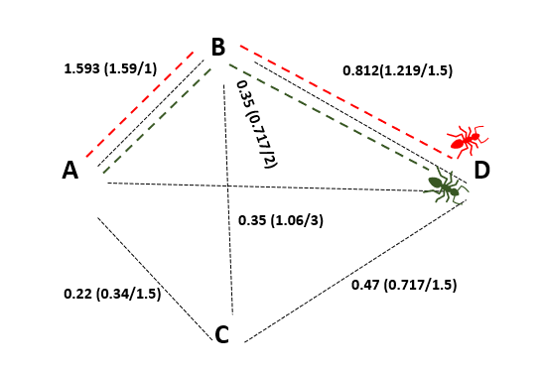
2 Ants
AB,BD
Path length : 2.5
Pheromone deposition : 1/2.5 (0.4)
AB,BD
Path length : 2.5
Pheromone deposition : 1/2.5 (0.4)
Edges
AB: 1; 1.62; (BD, BC)
AD: 3; 0.34; (---)
AC: 1.5; 0.73; (CD)
BD: 1.5; 1.219 (AB, CD)
CD: 1.5; 1.535; (---)
BC: 2; 0.34; (AC, AB, BD, CD)
Edges
AB: 1; 0.7*1.62+0.4+0.4; (BD, BC)
AD: 3; 0.7*0.34; (---)
AC: 1.5; 0.7*0.73; (CD)
BD: 1.5; 0.7*1.219+0.4+0.4 (AB, CD)
CD: 1.5; 0.7*1.535; (---)
BC: 2; 0.7*0.34; (AC, AB, BD, CD)
Edges
AB: 1; 1.93; (BD, BC)
AD: 3; 0.24; (---)
AC: 1.5; 0.511; (CD)
BD: 1.5; 1.65 (AB, CD)
CD: 1.5; 1.07; (---)
BC: 2; 0.24; (AC, AB, BD, CD)

Slide 38
INITIAL PHEROMONE LEVELS
AB: 1
AD: 1
AC: 1
BD: 1
CD: 1
BC: 1
FINAL PHEROMONE LEVELS
AB: 1.93
AD: 0.24
AC: 0.511
BD: 1.65
CD: 1.07
BC: 0.24

Slide 39

ACO – SHORTEST PATH PROBLEM
B
Edges:
AB
BD
AC
CD
AD
BC
CB
8
8
A
22
D
9
Name
Adjacent
Pheromone conc
Length
14
10
C

Slide 40
ACO – SHORTEST PATH PROBLEM
B
8
8
ab = ['AB',['BC','BD'],8,1]
A
22
D
9
14
10
C

Slide 41
ACO – SHORTEST PATH PROBLEM
B
8
8
ad = ['AD',[],22,1]
A
22
D
9
14
10
C

Slide 42
ACO – SHORTEST PATH PROBLEM
B
8
8
bc = ['BC',['CD’],9,1]
A
22
D
9
14
10
C

Slide 43
ACO – SHORTEST PATH PROBLEM
B
8
8
bd = ['BD',[],8,1]
A
22
D
9
14
10
C

Slide 44
ACO – SHORTEST PATH PROBLEM
B
8
8
ac = ['AC',[‘CB',’CD'],14,1]
A
22
D
9
14
10
C

Slide 45
ACO – SHORTEST PATH PROBLEM
B
8
8
cd = ['CD',[],10,1]
A
22
D
9
14
10
C

Slide 46
ACO – SHORTEST PATH PROBLEM
B
8
8
cb = ['CB',['BD'],9,1]
A
22
D
9
14
10
C

Slide 47
ACO – SHORTEST PATH PROBLEM
B
8
8
ab = ['AB',['BC','BD'],8,1]
ac = ['AC',['BC','BD'],14,1]
ad = ['AD',[],22,1]
bc = ['BC',['CD’],9,1]
cb = ['CB',['BD'],9,1]
bd = ['BD',[],8,1]
cd = ['CD',[],10,1]
A
22
D
9
14
10
C

Slide 48
Edge = [name, adjacent edges, length, pheromone level]
ab = ['AB',['BD','BE','BC'],5,1]
ac = ['AC',['CB','CD','CE'],6,1]
ae = ['AE',[],30,1]
bd = ['BD',['DE','DC'],6,1]
be = ['BE',[],16,1]
bc = ['BC',['CD','CE'],11,1]
cb = ['CB',['BD','BE'],11,1]
cd = ['CD',['DE'],17,1]
ce = ['CE',[],10,1]
de = ['DE',[],4,1]
dc = ['DC',['CE'],17,1]

Slide 49
ab = ['AB',['BD','BE','BC'],5,1]
ac = ['AC',['CB','CD','CE'],6,1]
ae = ['AE',[],30,1]
bd = ['BD',['DE','DC'],6,1]
be = ['BE',[],16,1]
bc = ['BC',['CD','CE'],11,1]
cb = ['CB',['BD','BE'],11,1]
cd = ['CD',['DE'],17,1]
ce = ['CE',[],10,1]
de = ['DE',[],4,1]
dc = ['DC',['CE'],17,1]
6
B
D
5
4
11
16
A
17
30
E
6
C
10

Slide 50
ab = ['AB',['BD','BE','BC'],5,1]
ac = ['AC',['CB','CD','CE'],6,1]
ae = ['AE',[],30,1]
bd = ['BD',['DE','DC'],6,1]
be = ['BE',[],16,1]
bc = ['BC',['CD','CE'],11,1]
cb = ['CB',['BD','BE'],11,1]
cd = ['CD',['DE'],17,1]
ce = ['CE',[],10,1]
de = ['DE',[],4,1]
dc = ['DC',['CE'],17,1]
6
B
D
5
4
11
16
A
17
30
E
6
C
10

Slide 51
ab = ['AB',['BD','BE','BC'],5,1]
ac = ['AC',['CB','CD','CE'],6,1]
ae = ['AE',[],30,1]
bd = ['BD',['DE','DC'],6,1]
be = ['BE',[],16,1]
bc = ['BC',['CD','CE'],11,1]
cb = ['CB',['BD','BE'],11,1]
cd = ['CD',['DE'],17,1]
ce = ['CE',[],10,1]
de = ['DE',[],4,1]
dc = ['DC',['CE'],17,1]
6
B
D
5
4
11
16
A
17
30
E
6
C
10

Slide 52
ab = ['AB',['BD','BE','BC'],5,1]
ac = ['AC',['CB','CD','CE'],6,1]
ae = ['AE',[],30,1]
bd = ['BD',['DE','DC'],6,1]
be = ['BE',[],16,1]
bc = ['BC',['CD','CE'],11,1]
cb = ['CB',['BD','BE'],11,1]
cd = ['CD',['DE'],17,1]
ce = ['CE',[],10,1]
de = ['DE',[],4,1]
dc = ['DC',['CE'],17,1]
6
B
D
5
4
11
16
A
17
30
E
6
C
10

Slide 53
ab = ['AB',['BD','BE','BC'],5,1]
ac = ['AC',['CB','CD','CE'],6,1]
ae = ['AE',[],30,1]
bd = ['BD',['DE’],6,1]
be = ['BE',[],16,1]
bc = ['BC',['CD','CE'],11,1]
cb = ['CB',['BD','BE'],11,1]
cd = ['CD',['DE'],17,1]
ce = ['CE',[],10,1]
de = ['DE',[],4,1]
dc = ['DC',['CE'],17,1]
6
B
D
5
4
11
16
A
17
30
E
6
C
10

Slide 54
ab = ['AB',['BD','BE','BC'],5,1]
ac = ['AC',['CB','CD','CE'],6,1]
ae = ['AE',[],30,1]
bd = ['BD',['DE','DC'],6,1]
be = ['BE',[],16,1]
bc = ['BC',['CD','CE'],11,1]
cb = ['CB',['BD','BE'],11,1]
cd = ['CD',['DE'],17,1]
ce = ['CE',[],10,1]
de = ['DE',[],4,1]
dc = ['DC',['CE'],17,1]
6
B
D
5
4
11
16
A
17
30
E
6
C
10

Slide 55
6
ab = ['AB',['BD','BE','BC'],5,1]
ac = ['AC',['CB','CD','CE'],6,1]
ae = ['AE',[],30,1]
bd = ['BD',['DE','DC'],6,1]
be = ['BE',[],16,1]
bc = ['BC',['CD','CE'],11,1]
cb = ['CB',['BD','BE'],11,1]
cd = ['CD',['DE'],17,1]
ce = ['CE',[],10,1]
de = ['DE',[],4,1]
dc = ['DC',['CE'],17,1]
B
D
5
4
11
16
17
A
30
E
6
C
10

Slide 56
6
ab = ['AB',['BD','BE','BC'],5,1]
ac = ['AC',['CB','CD','CE'],6,1]
ae = ['AE',[],30,1]
bd = ['BD',['DE','DC'],6,1]
be = ['BE',[],16,1]
bc = ['BC',['CD','CE'],11,1]
cb = ['CB',['BD','BE'],11,1]
cd = ['CD',['DE'],17,1]
ce = ['CE',[],10,1]
de = ['DE',[],4,1]
dc = ['DC',['CE'],17,1]
B
D
5
4
11
16
A
17
30
E
6
C
10

Slide 57
ab = ['AB',['BD','BE','BC'],5,1]
ac = ['AC',['CB','CD','CE'],6,1]
ae = ['AE',[],30,1]
bd = ['BD',['DE','DC'],6,1]
be = ['BE',[],16,1]
bc = ['BC',['CD','CE'],11,1]
cb = ['CB',['BD','BE'],11,1]
cd = ['CD',['DE'],17,1]
ce = ['CE',[],10,1]
de = ['DE',[],4,1]
dc = ['DC',['CE'],17,1]
6
B
D
5
4
11
16
A
17
30
E
6
C
10

Slide 58
ab = ['AB',['BD','BE','BC'],5,1]
ac = ['AC',['CB','CD','CE'],6,1]
ae = ['AE',[],30,1]
bd = ['BD',['DE','DC'],6,1]
be = ['BE',[],16,1]
bc = ['BC',['CD','CE'],11,1]
cb = ['CB',['BD','BE'],11,1]
cd = ['CD',['DE'],17,1]
ce = ['CE',[],10,1]
de = ['DE',[],4,1]
dc = ['DC',['CE'],17,1]
6
B
D
5
4
11
16
A
17
30
E
6
C
10

Slide 59
ab = ['AB',['BD','BE','BC'],5,1]
ac = ['AC',['CB','CD','CE'],6,1]
ae = ['AE',[],30,1]
bd = ['BD',['DE','DC'],6,1]
be = ['BE',[],16,1]
bc = ['BC',['CD','CE'],11,1]
cb = ['CB',['BD','BE'],11,1]
cd = ['CD',['DE'],17,1]
ce = ['CE',[],10,1]
de = ['DE',[],4,1]
dc = ['DC',['CE'],17,1]
6
B
D
5
4
11
16
A
17
30
E
6
C
10

Slide 60
ab = ['AB',['BD','BE','BC'],5,1]
ac = ['AC',['CB','CD','CE'],6,1]
ae = ['AE',[],30,1]
bd = ['BD',['DE','DC'],6,1]
be = ['BE',[],16,1]
bc = ['BC',['CD','CE'],11,1]
cb = ['CB',['BD','BE'],11,1]
cd = ['CD',['DE'],17,1]
ce = ['CE',[],10,1]
de = ['DE',[],4,1]
dc = ['DC',['CE'],17,1]
6
B
D
5
4
11
16
A
17
30
E
6
C
10

